Slide 1

Basics of Sampling Design
Dr. Marcos Angelini & Dr Luis Rodríguez-Lado

Slide 2
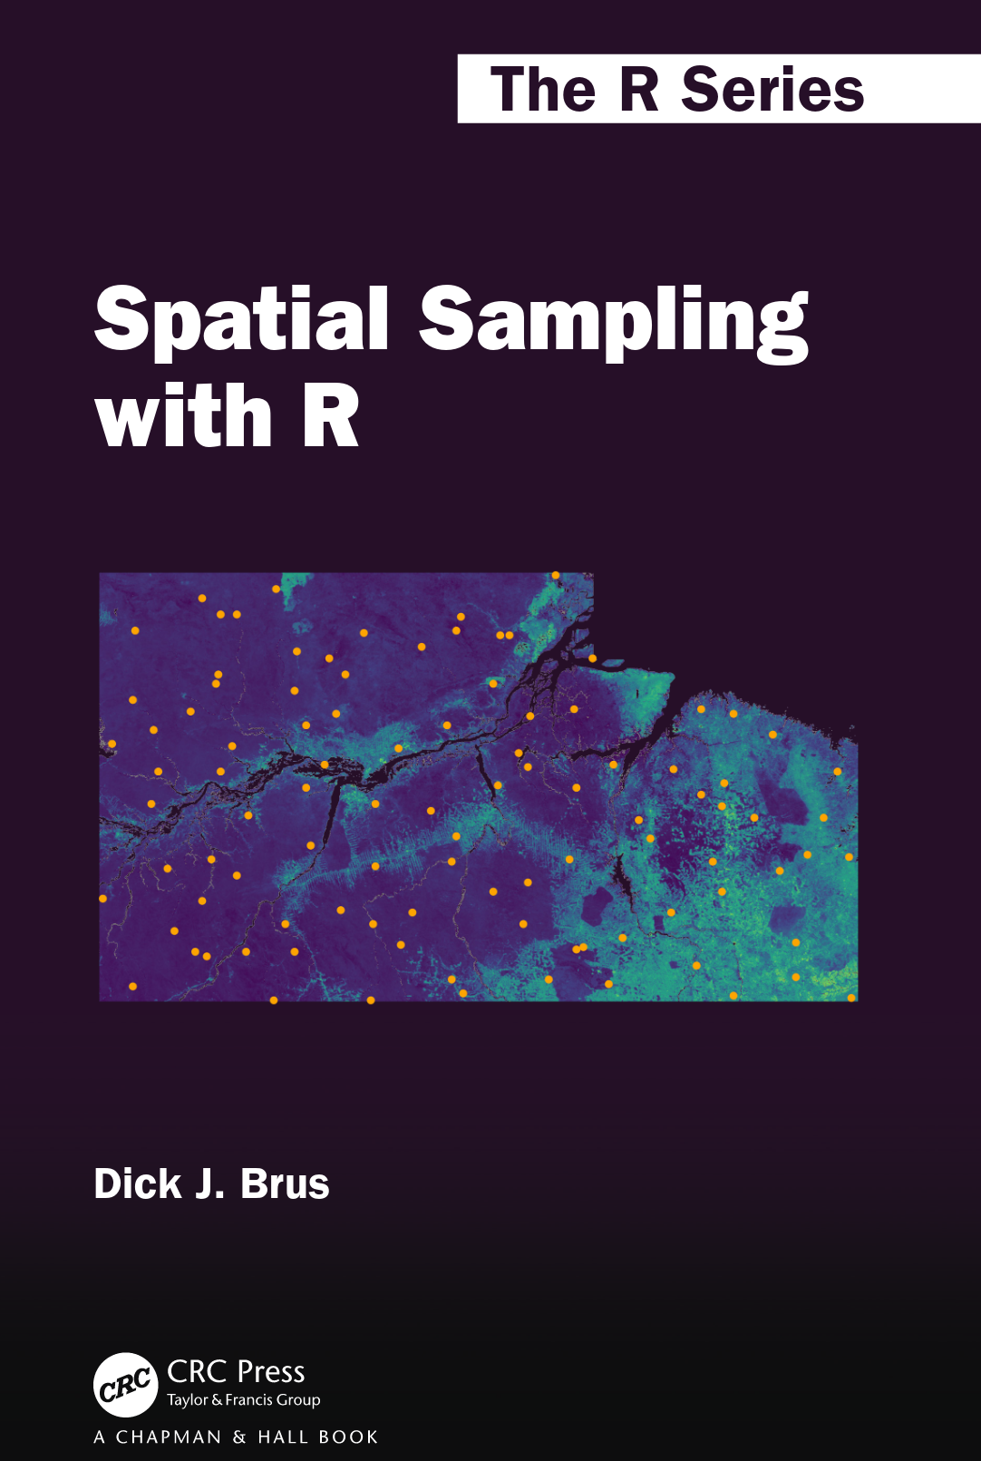

Acknowledgment
Dr. Dick Brus
https://github.com/DickBrus

Slide 3
Purpose and basic principles of soil sampling
When it comes to nutrient levels, do we need to determine the most likely level of an area or where the level falls below a specific threshold?
How many samples we need?
Where samples have to be collected?
Single samples or compound samples?
What is the sampling frequency we need for soil monitoring?

Slide 4

Purpose and basic principles of soil sampling
What is a survey of a spatial variable?
A survey is an inventory of an object of study that, in general, cannot be measured completely and from which statistical statements will be made.
The target spatial variable is a variable that has a spatial distribution, such as the concentration soil organic carbon or the total nitrogen in the first 30 cm of the soil.
The true value of the spatial variable is referred to as the target population
We cannot determine the mean of the target population because we cannot measure the value of the spatial variable everywhere. However, we can estimate it with some degree of error.
"Known" is not equivalent to "estimated". In fact, "known" is equal to "estimated" plus the "error" margin.
The selection of a proper sampling strategy is crucial to obtain the most accurate estimation of the statistical population.
What is the proportion of red balls?

Slide 5
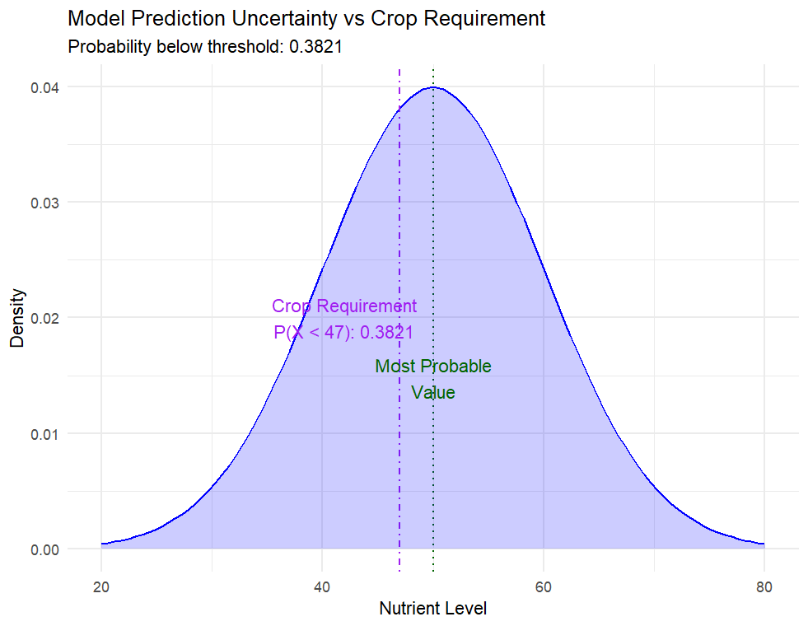
Purpose and basic principles of soil sampling
The blue area is the representation of the error in the estimation of the nutrient level
The green line represents the most probable value (conditional mean)
The purple line is the crop requirement nutrient level
According to the error, there is 38.21% probability that the true level of the nutrient is below the crop requirement
The error can be reduced by increasing sample size and improving data quality.

Slide 6
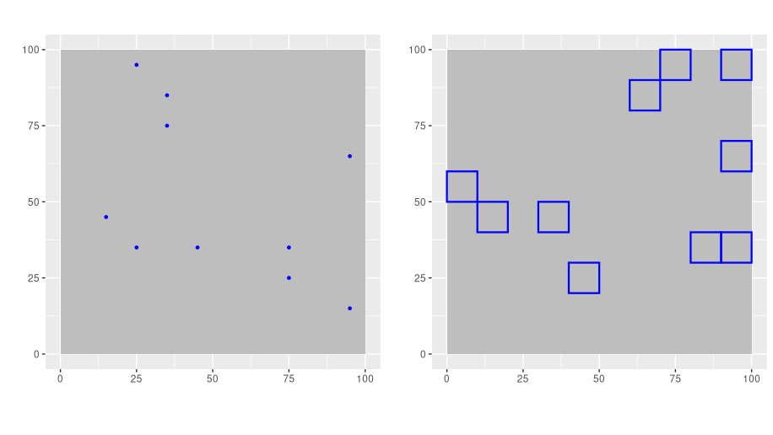
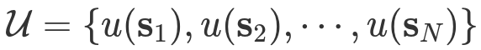
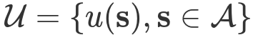
Purpose and basic principles of soil sampling
Type of populations:
Discrete (agricultural fields)
Continuous (soil samples)
The parameters of the population (mean, median, proportion, etc.) are estimated according to the sample support.
Point support (continuous)
Area support (discrete)
Figure based on Dick J. Brus 2021, Spatial sampling with R

Slide 7
Sampling approaches
Model-based
Non-probabilistic
The sample distribution is optimised to make a statistical model more accurate
Assumes that the covariates represent the variability of our target soil property
It is useful for mapping the most probable values
Most common method: cHLS, geostatistics
Design-based
Probability sampling
The sample distribution is based on random distribution
Strata can represent the variability of the landscape
Useful for estimating parameters of the population (mean SOC of an area) or for validating an existing map.
Most common method: Stratified Simple Random Sampling

Slide 8
Any question?

